Slide 1
Computer Organization
Mack 2021

Slide 2
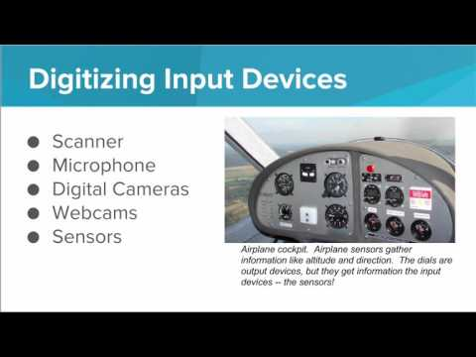
We learn about the various devices that make up computers and computer networks.

Slide 3
What is the purpose of an output device?
Notes:
🍐 This is a Pear Deck Multiple Choice Slide. Your current options are: A: To allow the computer to store information or programs., B: To allow the user to give data or information to the computer., C: To allow computers to connect and communicate with other computers., D: To allow the computer to display or communicate the result of a computation,
🍐 To edit the type of question or choices, go back to the "Ask Students a Question" in the Pear Deck sidebar.
D

Slide 4
What is the purpose of an input device?
Notes:
🍐 This is a Pear Deck Multiple Choice Slide. Your current options are: A: To allow the computer to store information or programs., B: To allow the user to give data or information to the computer., C: To allow computers to connect and communicate with other computers., D: To allow the computer to display or communicate the result of a computation,
🍐 To edit the type of question or choices, go back to the "Ask Students a Question" in the Pear Deck sidebar.
B

Slide 5
What is the purpose of a network device?
Notes:
🍐 This is a Pear Deck Multiple Choice Slide. Your current options are: A: To allow the computer to store information or programs., B: To allow the user to give data or information to the computer., C: To allow computers to connect and communicate with other computers., D: To allow the computer to display or communicate the result of a computation,
🍐 To edit the type of question or choices, go back to the "Ask Students a Question" in the Pear Deck sidebar.
C

Slide 6
What is the purpose of a storage device?
Notes:
🍐 This is a Pear Deck Multiple Choice Slide. Your current options are: A: To allow the computer to store information or programs., B: To allow the user to give data or information to the computer., C: To allow computers to connect and communicate with other computers., D: To allow the computer to display or communicate the result of a computation,
🍐 To edit the type of question or choices, go back to the "Ask Students a Question" in the Pear Deck sidebar.
A

Slide 7
Draw a Computer
In the sketchpad, draw a diagram of a computer.
Your computer should have:
At least two input devices
At least two output devices
Be sure to label each part. Show your diagram to your neighbor. Does he/she agree that you’ve labelled the diagram correctly?
Note: if you have issues loading this assignment, please go to the following url: https://sketch.io/sketchpad/

Slide 8
Choose what kind of device a mouse is.
Notes:
🍐 This is a Pear Deck Multiple Choice Slide. Your current options are: A: Input Device, B: Output Device, C: Storage Device, D: Network Device,
🍐 To edit the type of question or choices, go back to the "Ask Students a Question" in the Pear Deck sidebar.

Slide 9
Choose what kind of device a web-camera is.
Notes:
🍐 This is a Pear Deck Multiple Choice Slide. Your current options are: A: Input Device, B: Output Device, C: Storage Device, D: Network Device,
🍐 To edit the type of question or choices, go back to the "Ask Students a Question" in the Pear Deck sidebar.

Slide 10
Choose what kind of device a “USB Drive* is.
Notes:
🍐 This is a Pear Deck Multiple Choice Slide. Your current options are: A: Input Device, B: Output Device, C: Storage Device, D: Network Device,
🍐 To edit the type of question or choices, go back to the "Ask Students a Question" in the Pear Deck sidebar.

Slide 11
Choose what kind of device a “speaker* is.
Notes:
🍐 This is a Pear Deck Multiple Choice Slide. Your current options are: A: Input Device, B: Output Device, C: Storage Device, D: Network Device,
🍐 To edit the type of question or choices, go back to the "Ask Students a Question" in the Pear Deck sidebar.

Slide 12
Choose what kind of device a “router* is.
Notes:
🍐 This is a Pear Deck Multiple Choice Slide. Your current options are: A: Input Device, B: Output Device, C: Storage Device, D: Network Device,
🍐 To edit the type of question or choices, go back to the "Ask Students a Question" in the Pear Deck sidebar.

